Slide 1
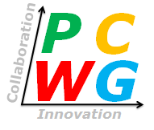
PCWG 2016 Roadmap: Detailed Survey Results
PCWG
15th Meeting December 2015 – Kings Langley

Slide 2
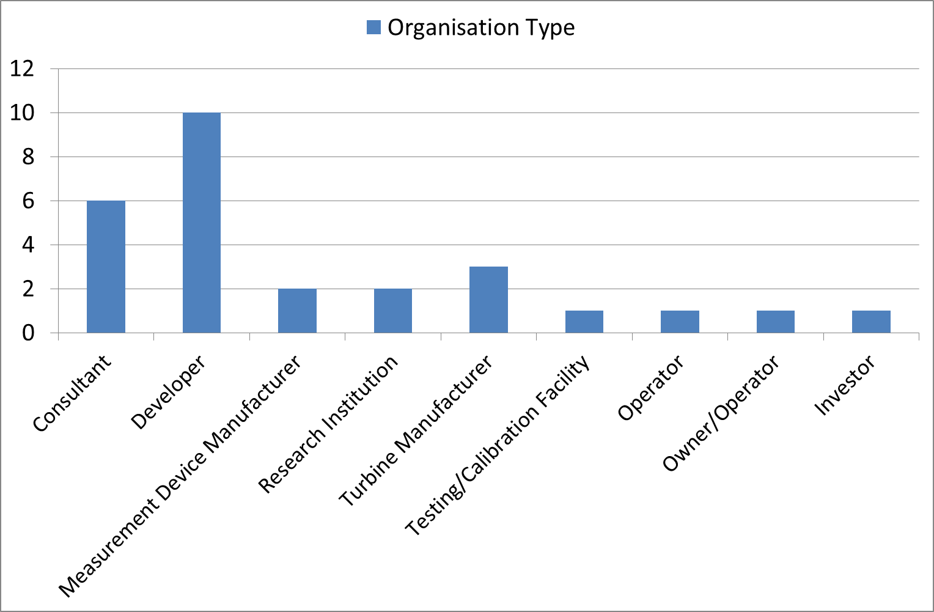
27 Responses in Total (from 16 distinct organisations)

Slide 3
Classifications
 | Range | Count
Strong Positive | 1.5 to 2.0 | 3
Positive | 1.0 to 1.5 | 15
Weak Positive | 0.5 to 1.0 | 13
Neutral | -0.5 to 0.5 | 0
Weak Negative | -1.0 to -0.5 | 0
Negative | -1.5 to -1.0 | 0
Strong Negative | -2.0 to -1.5 | 0

Slide 4
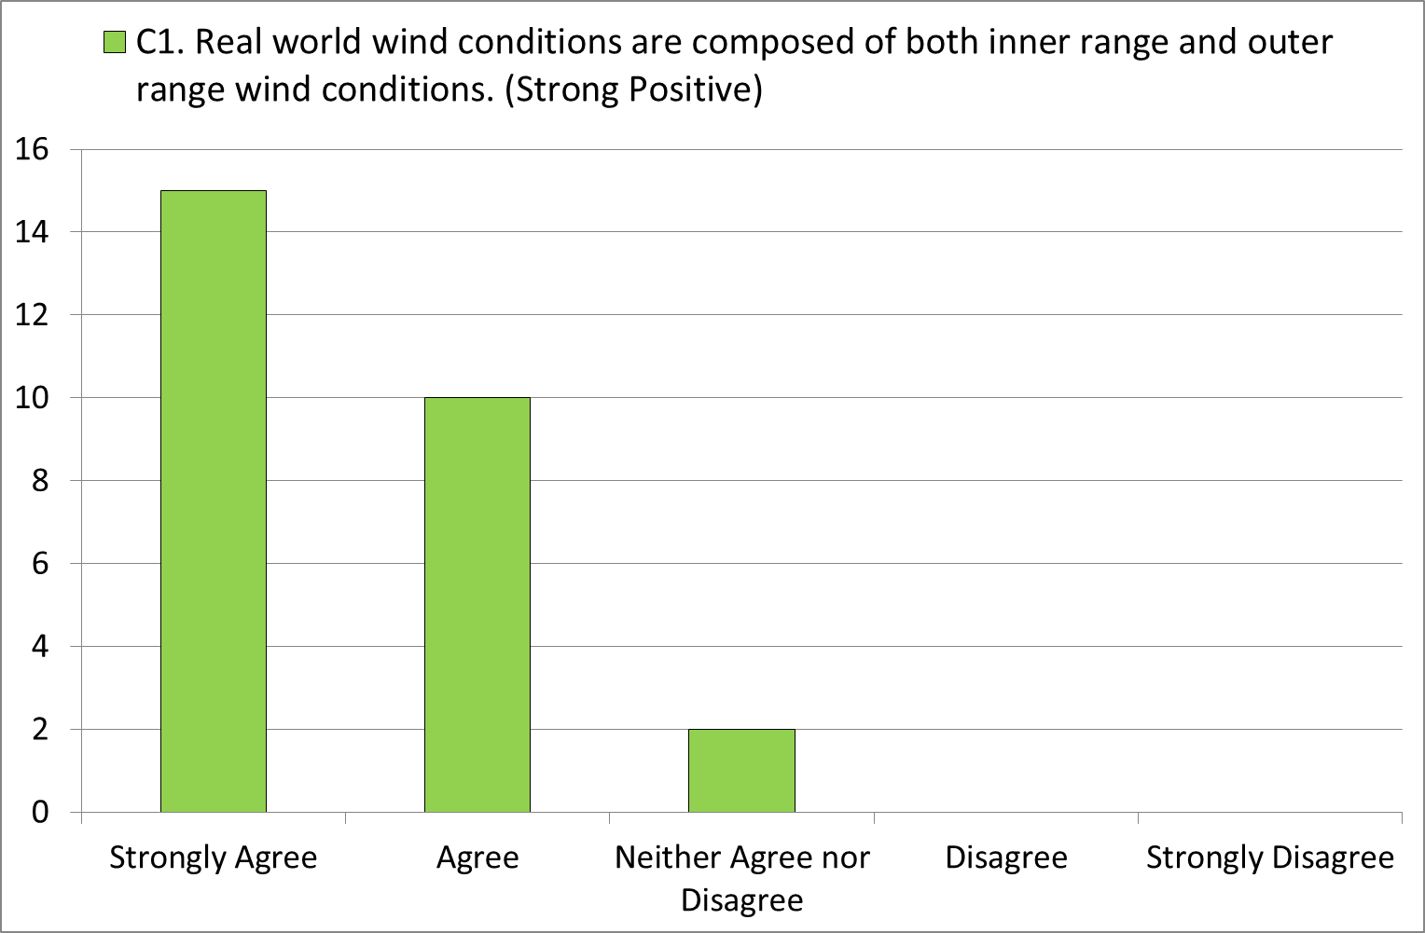
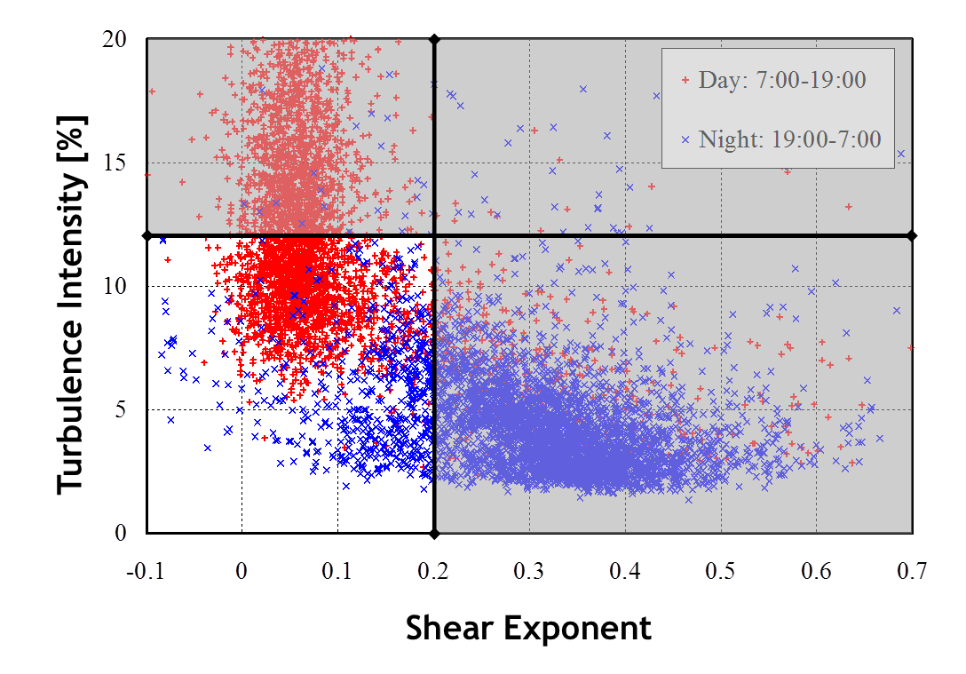
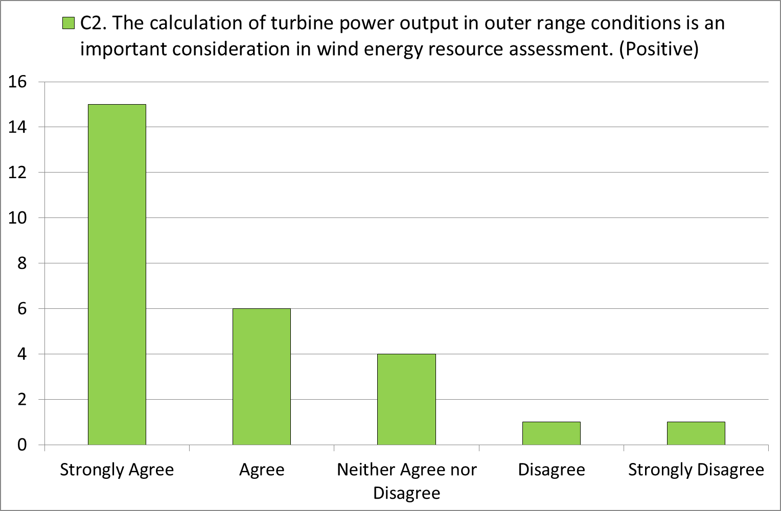
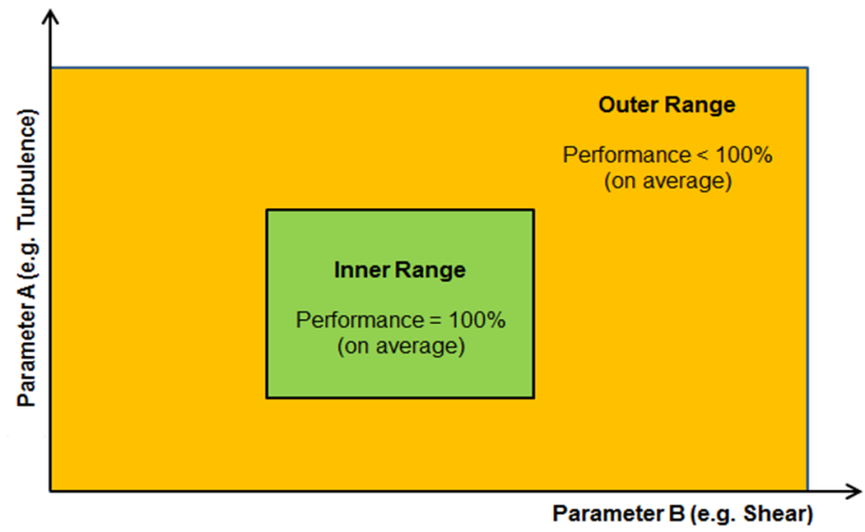

Slide 5
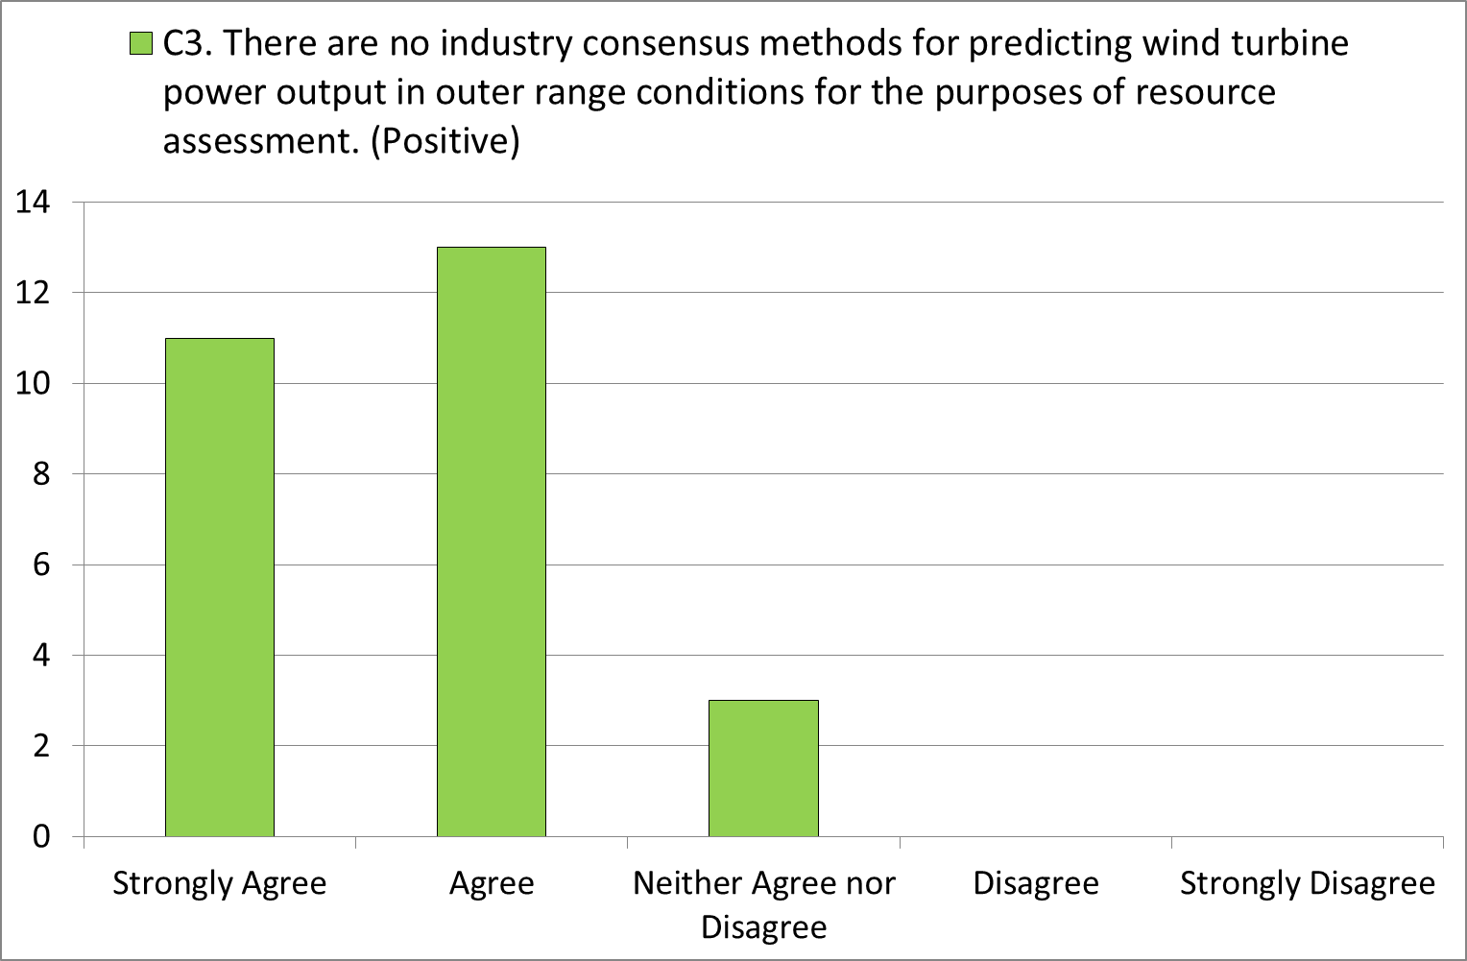
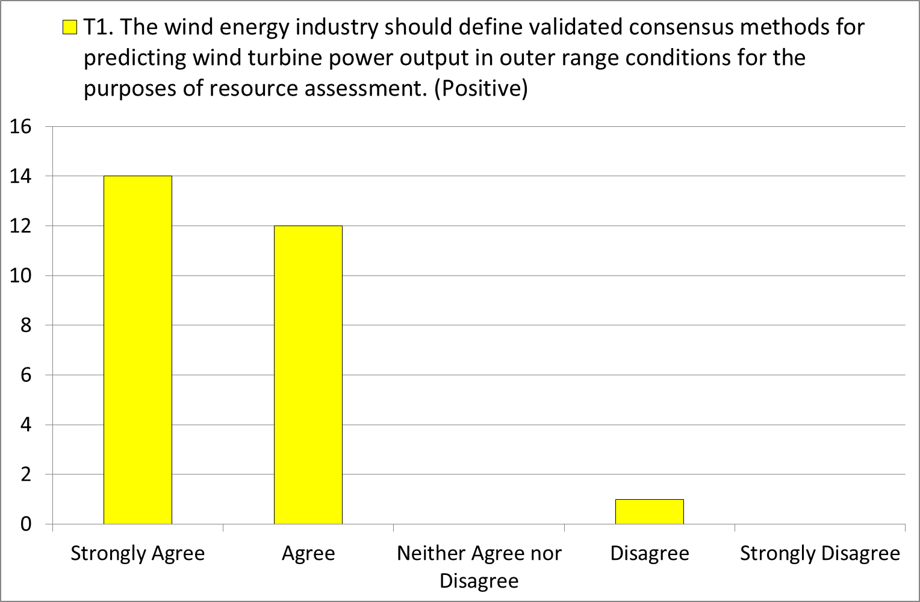

Slide 6
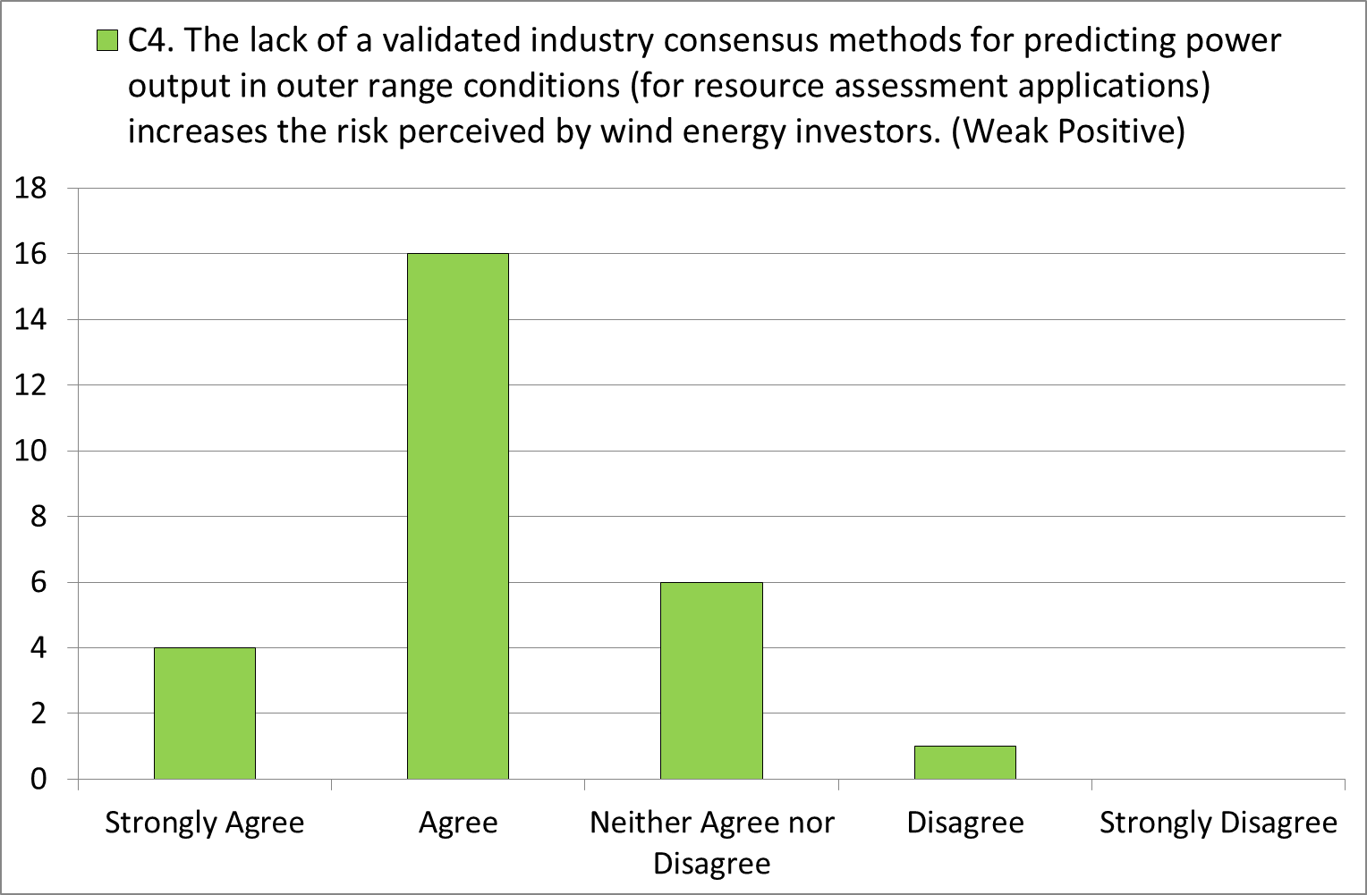

Slide 7
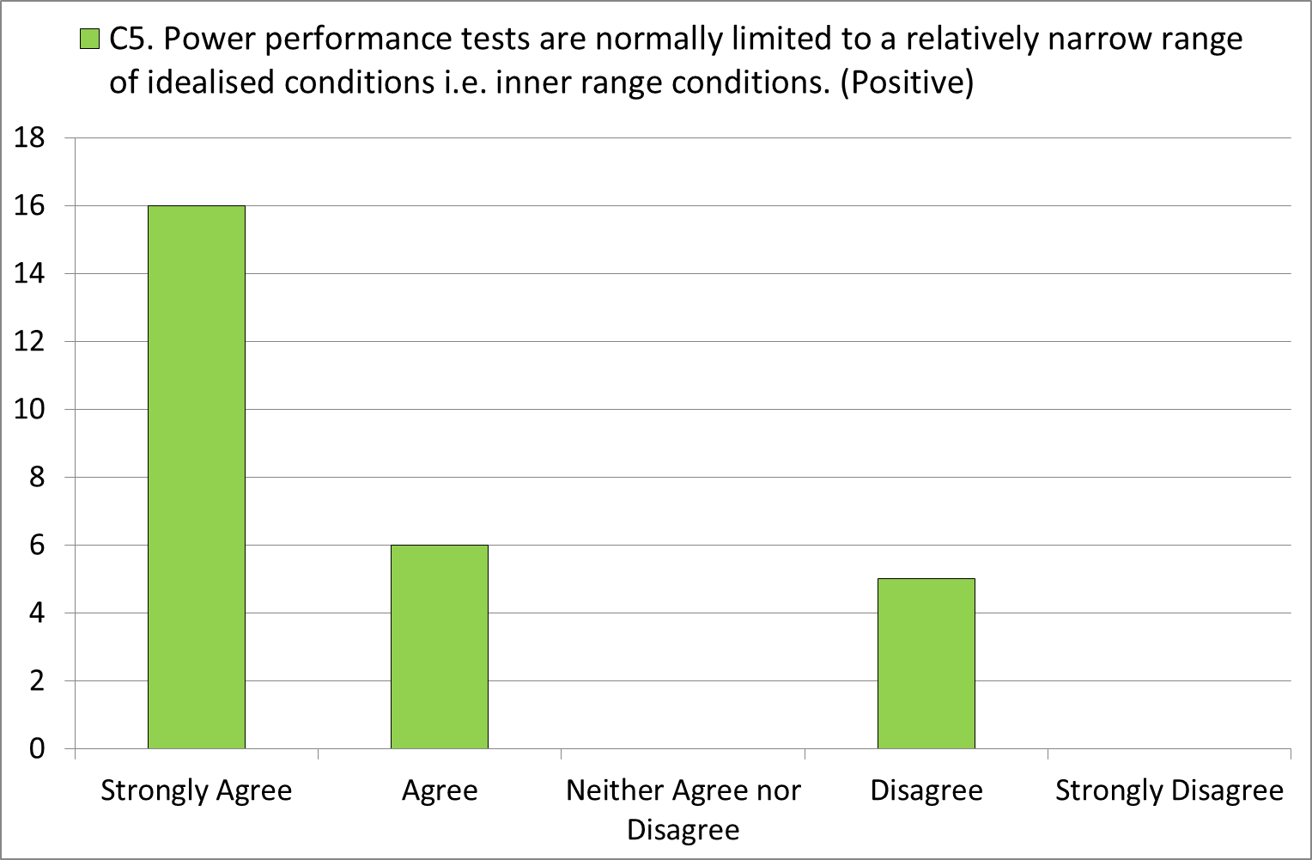
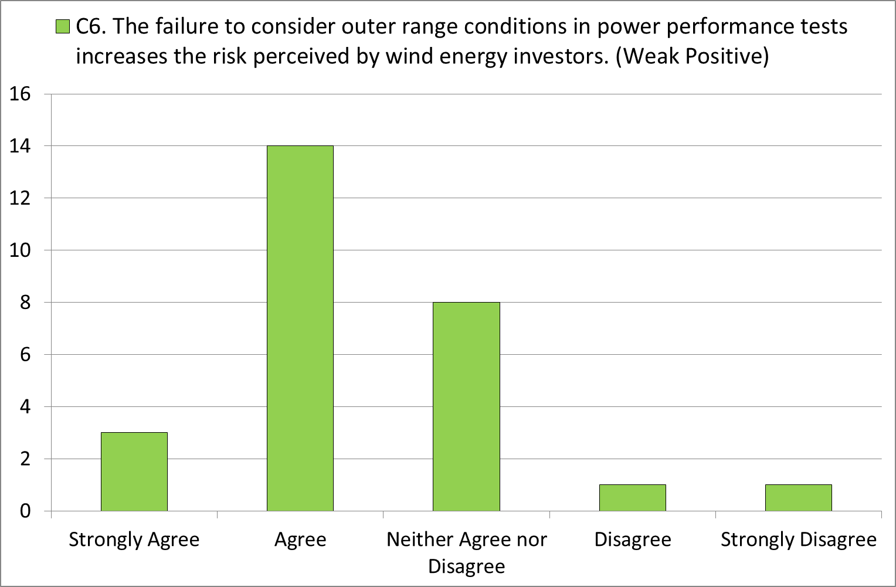
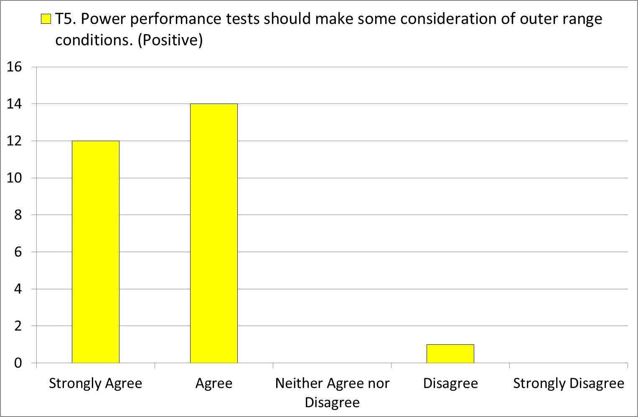

Slide 8
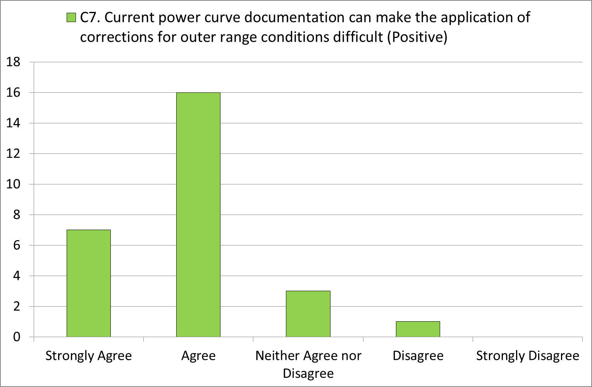
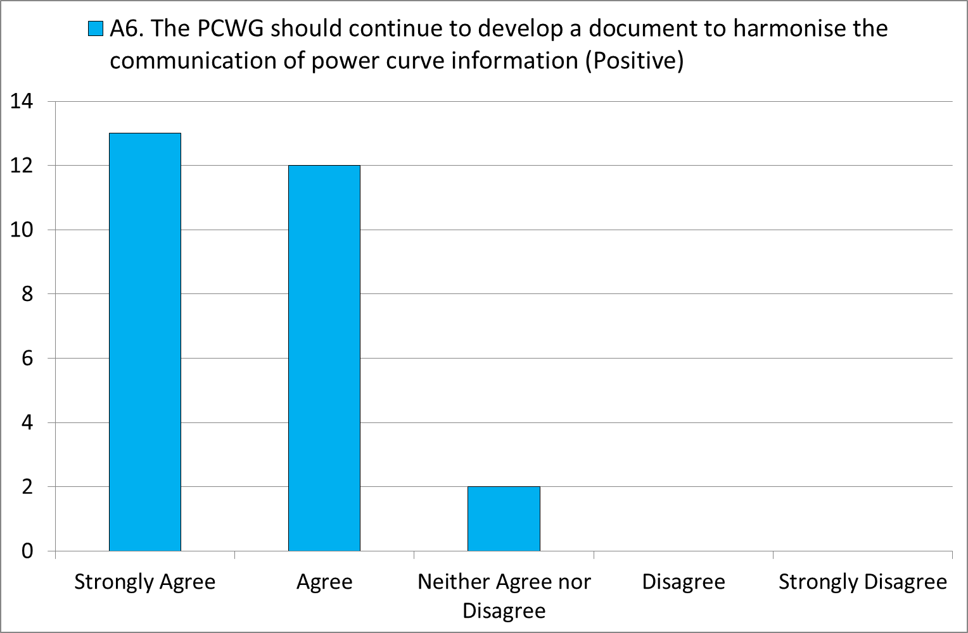
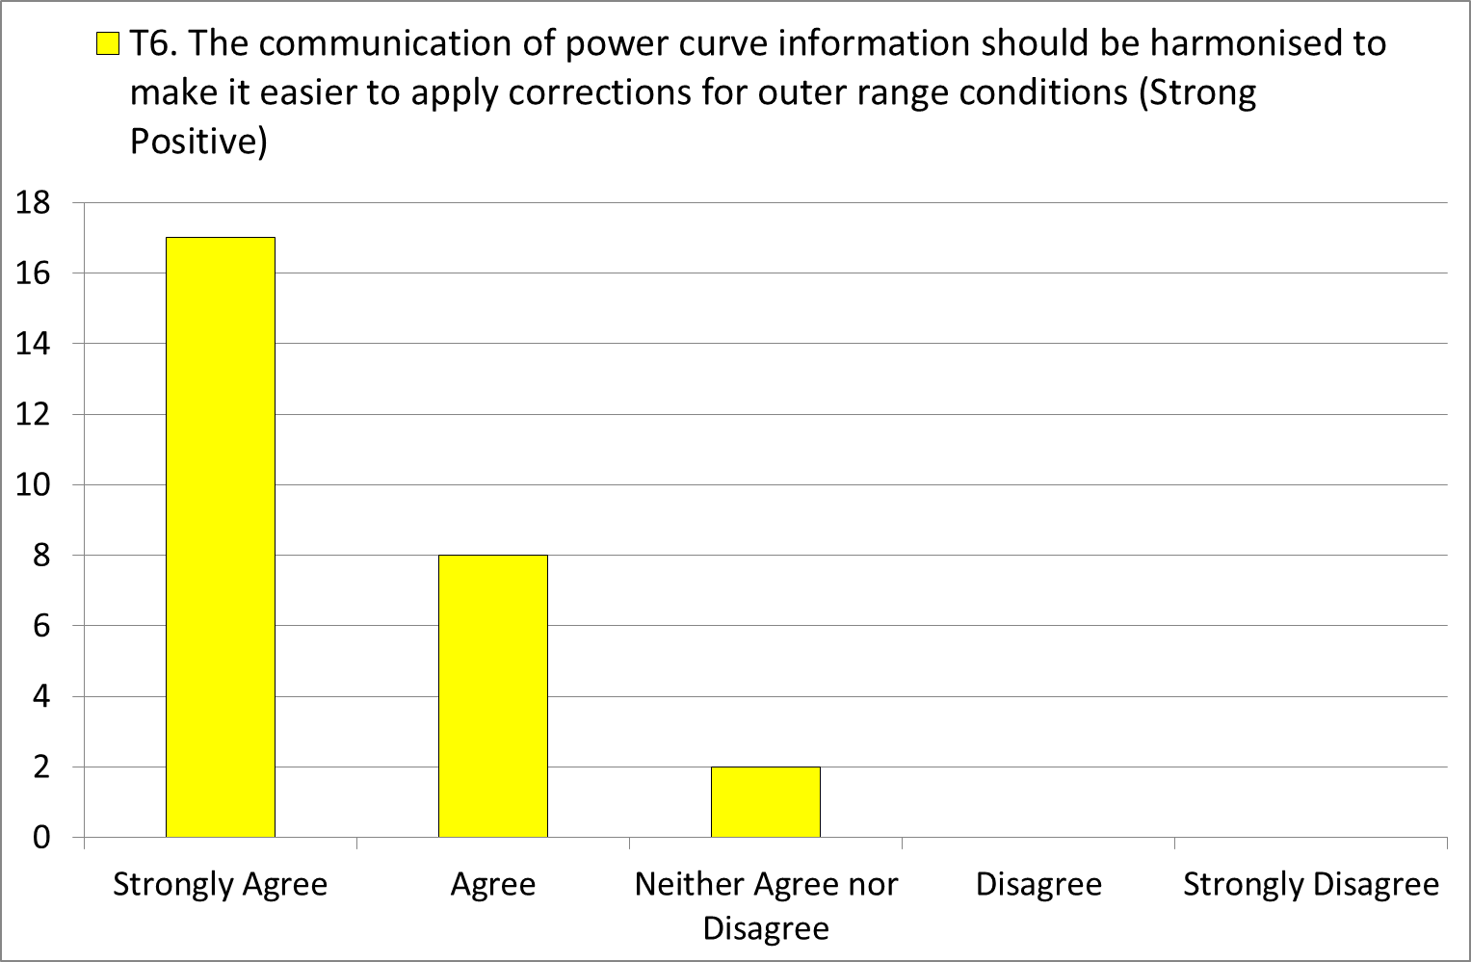
Comment from participant:
Harmonisation of info is key

Slide 9
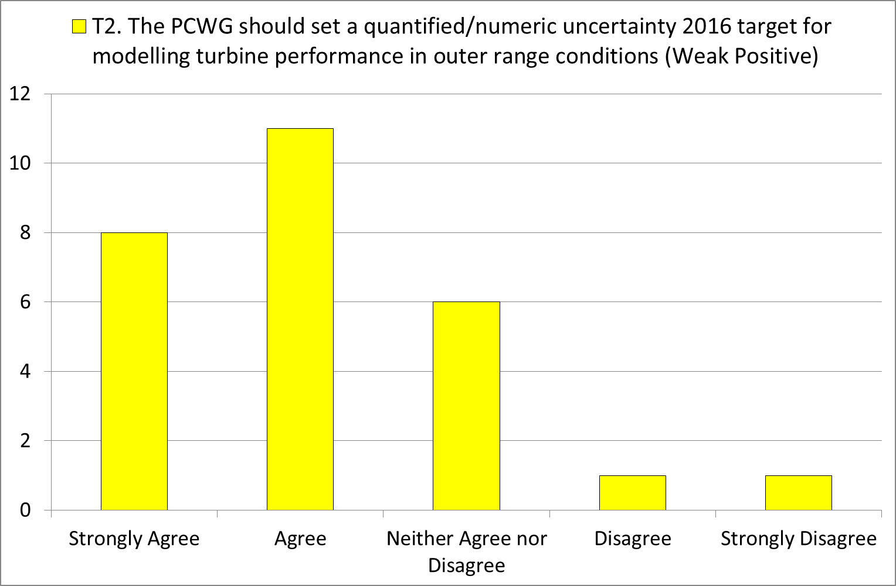

Slide 10
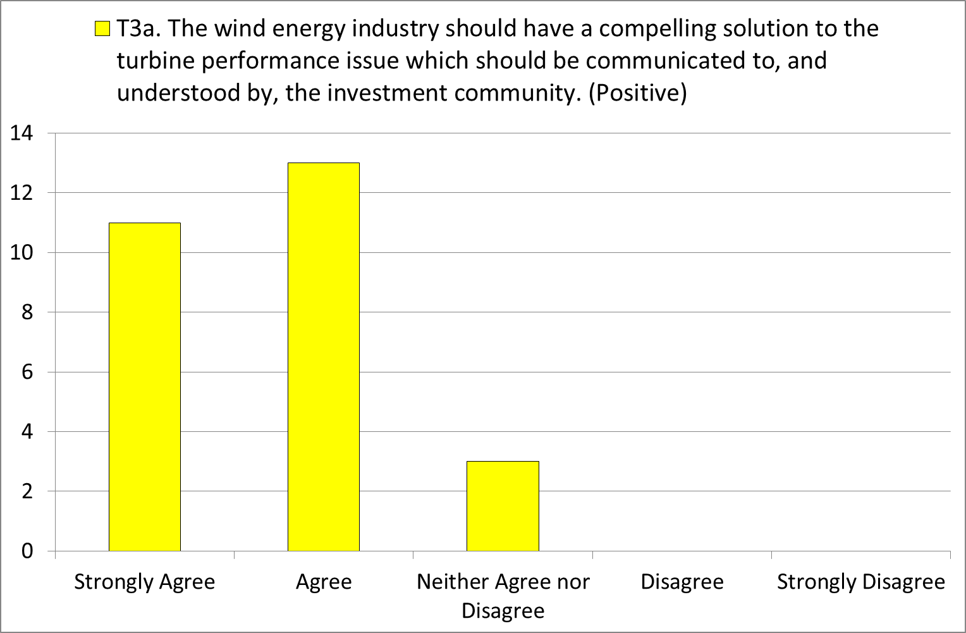
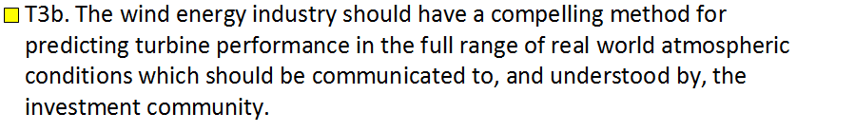
Some concerns have been raised regarding the wording of this question and an alternative phrasing has been proposed.
Does everyone agree the revised wording is better?

Slide 11
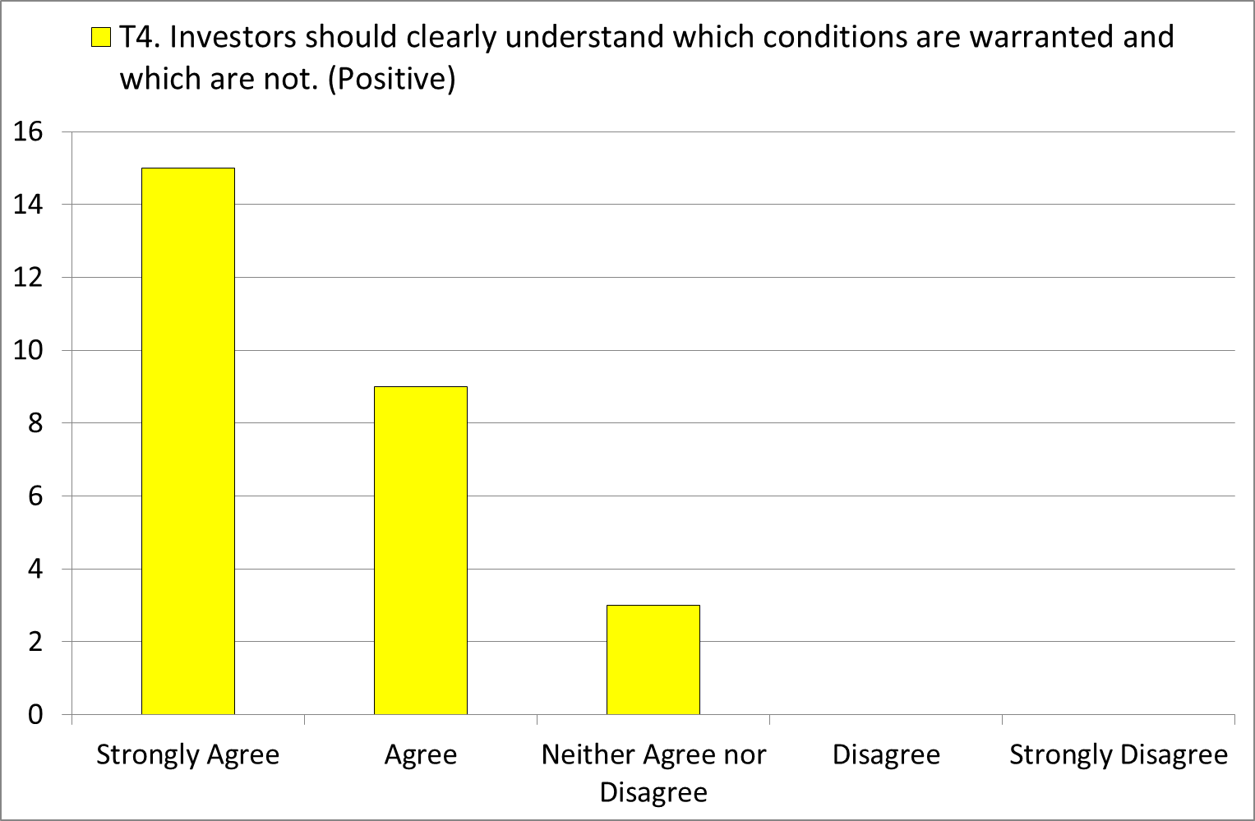

Slide 12
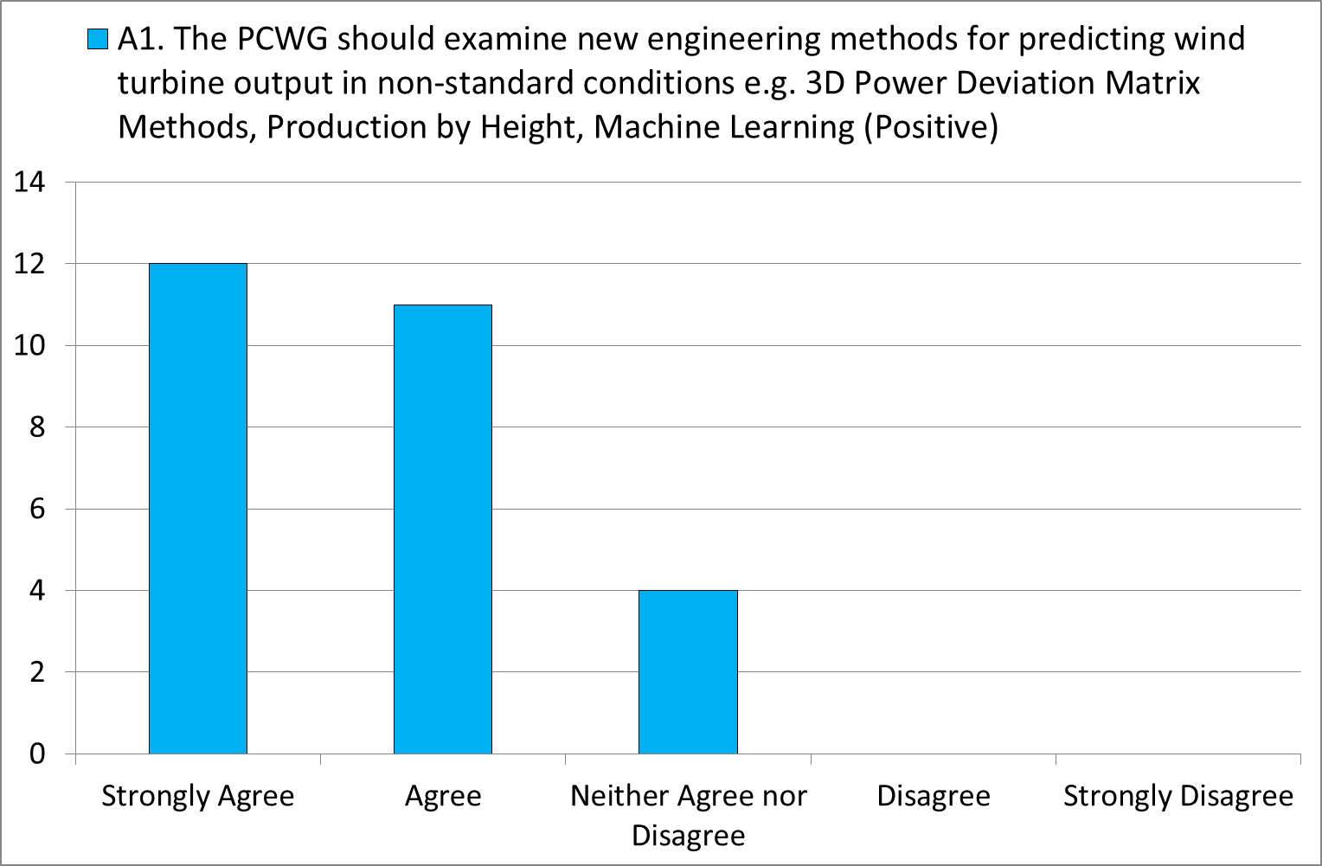
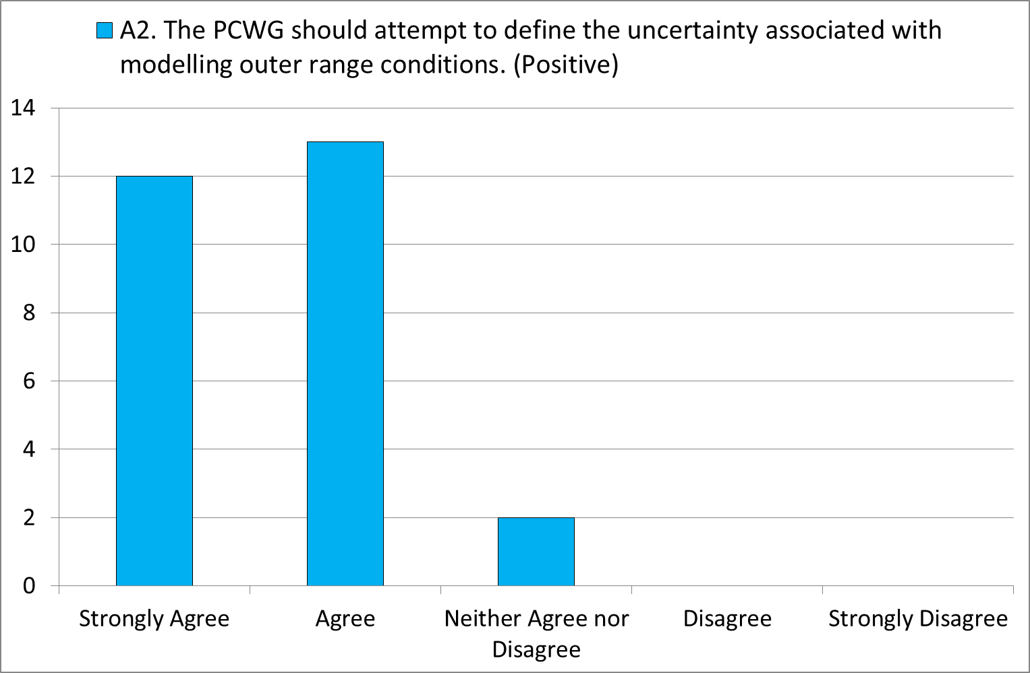

Slide 13
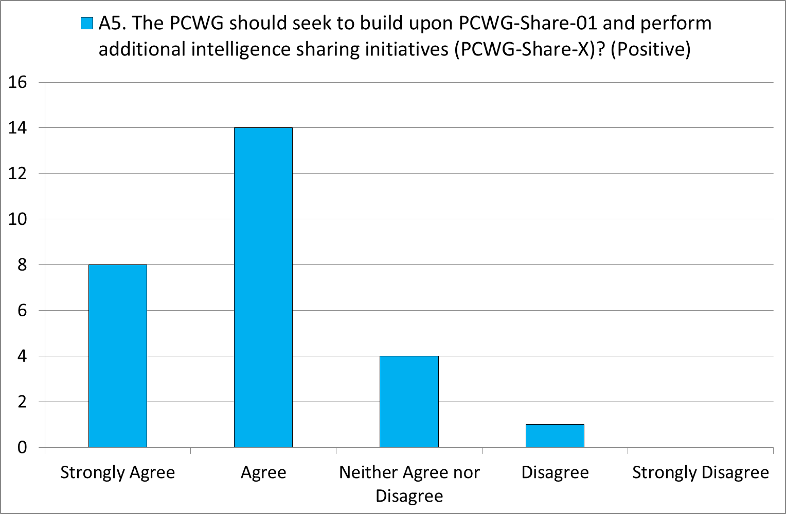

Slide 14
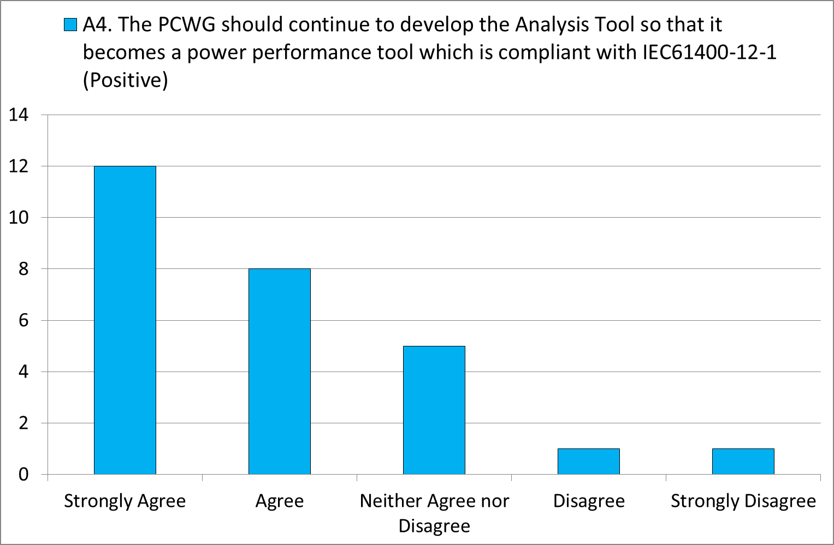
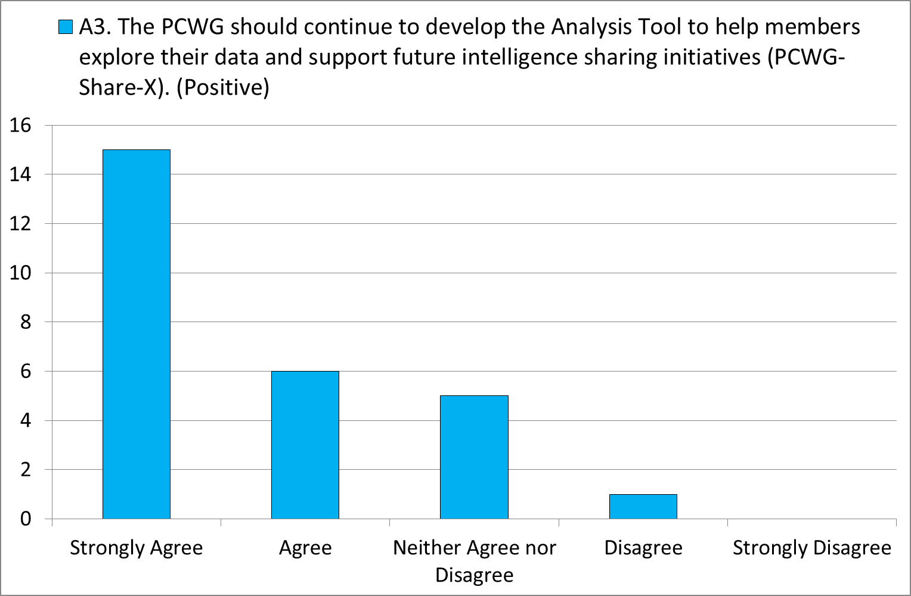

Slide 15
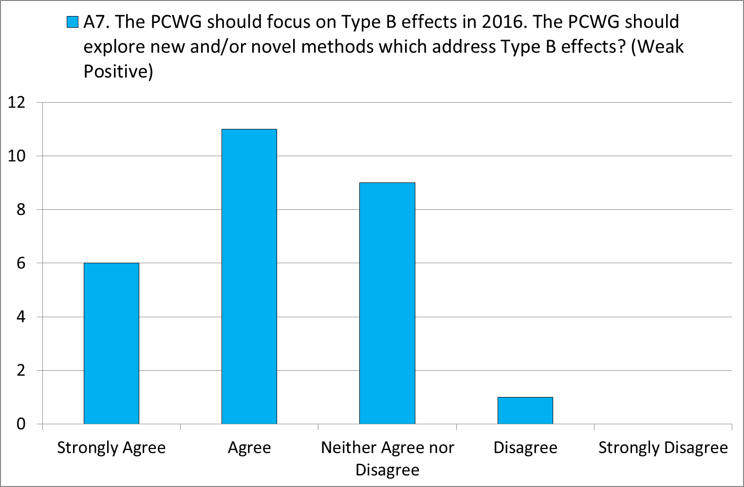

Slide 16
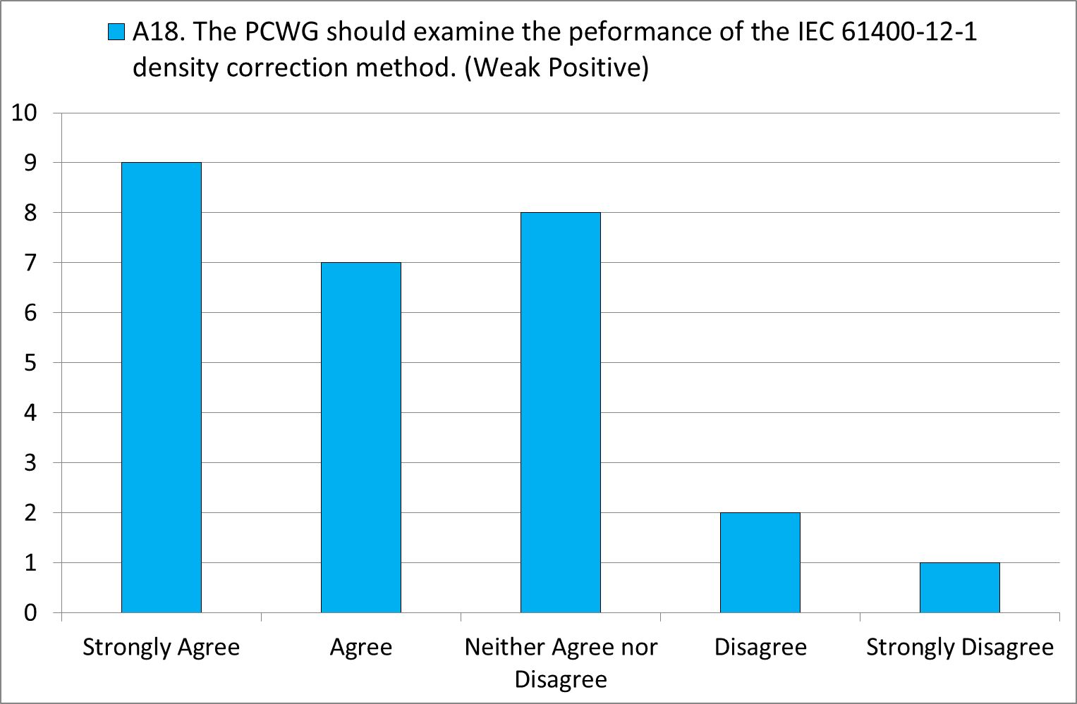

Slide 17
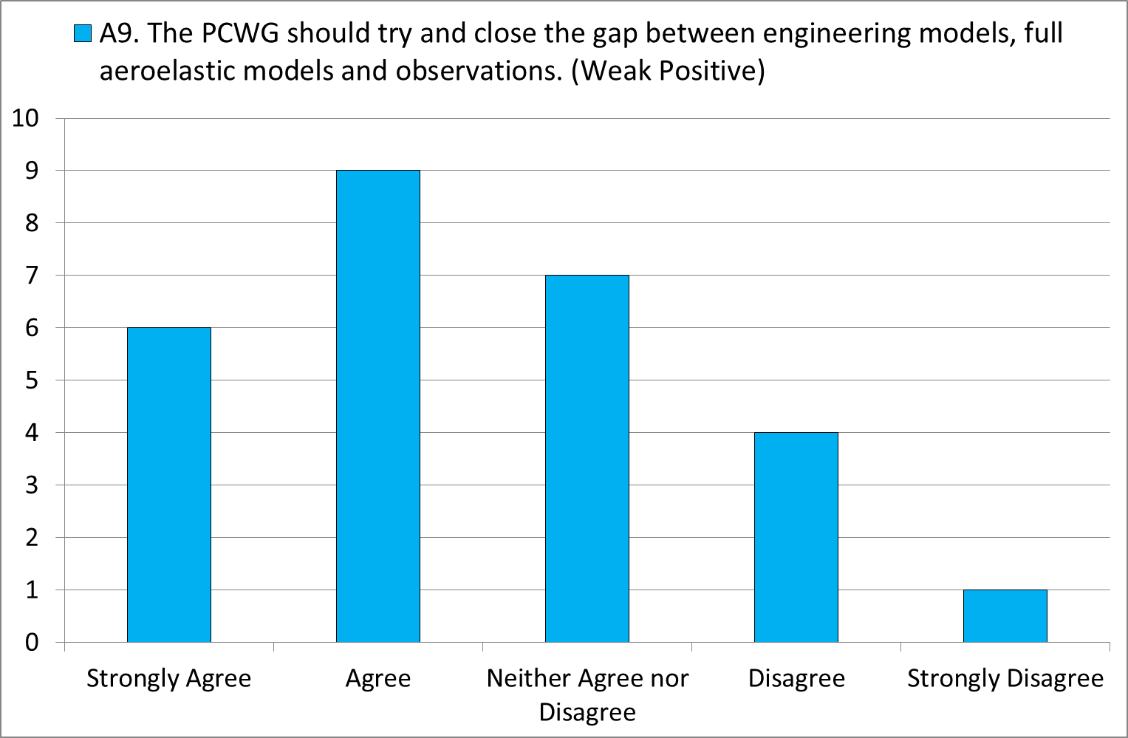
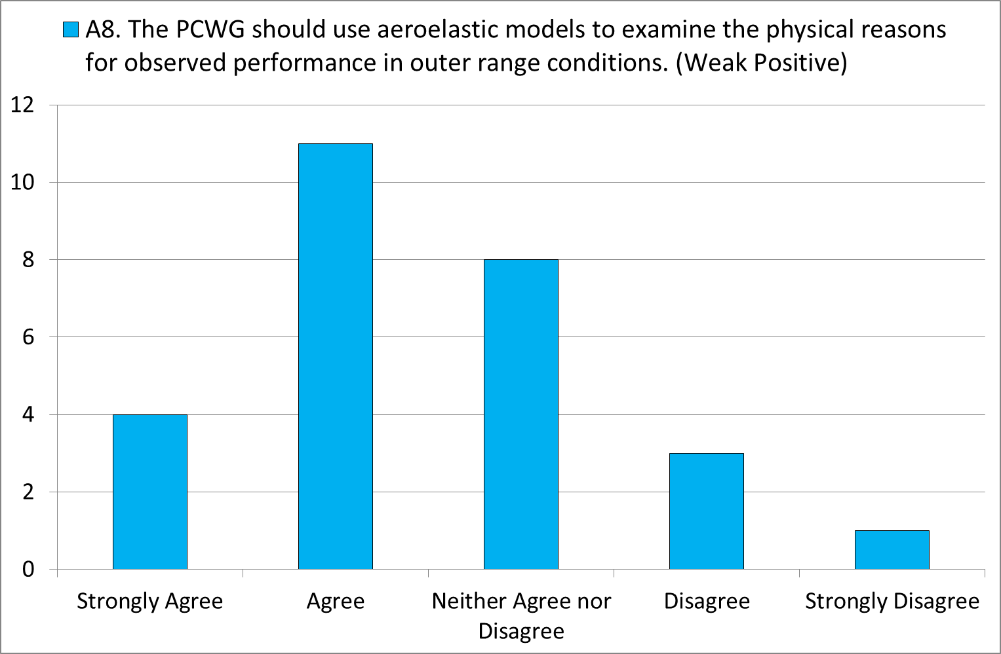

Slide 18
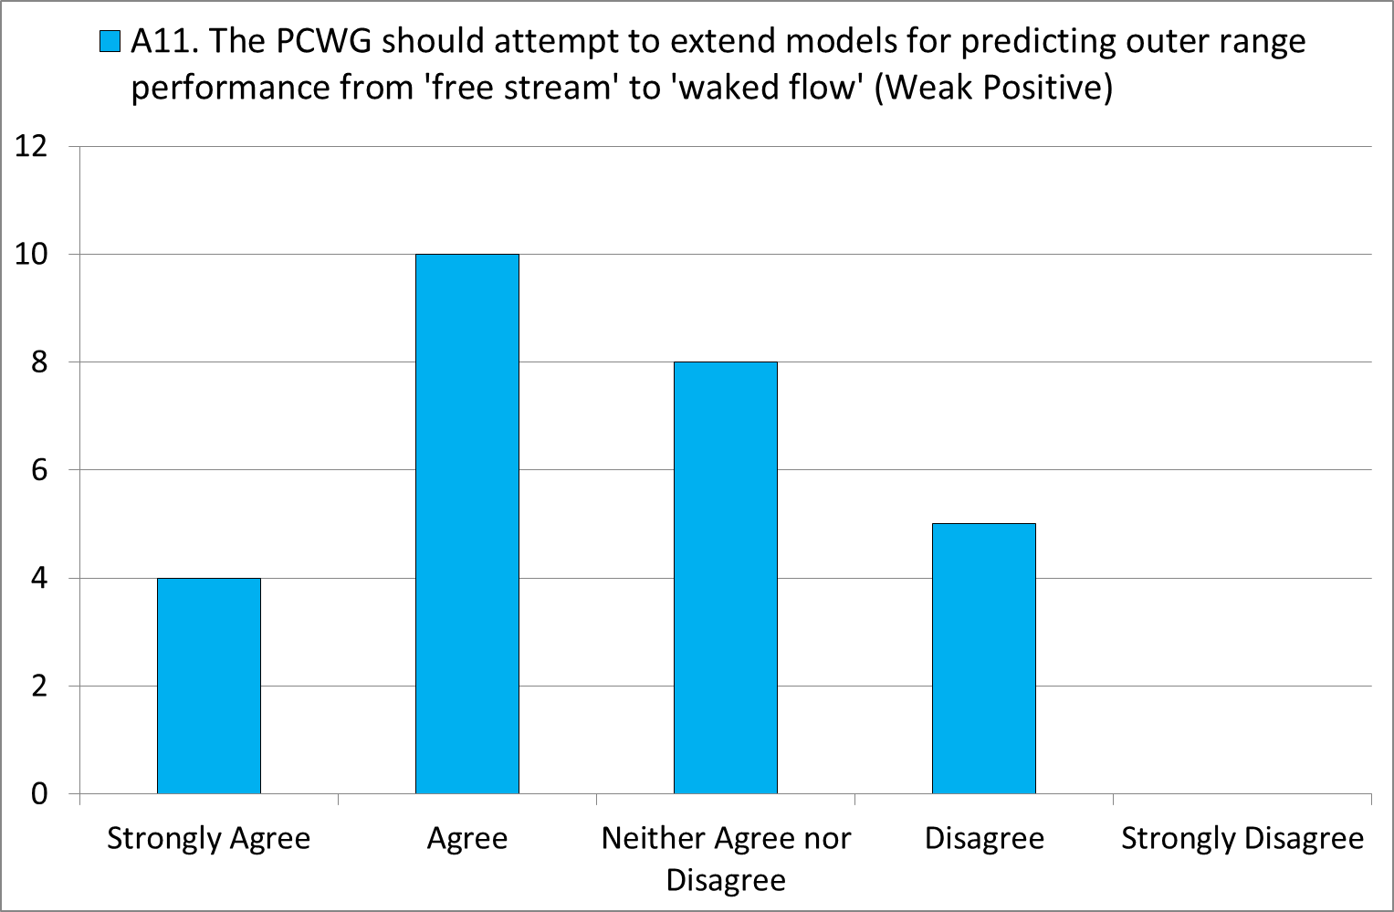
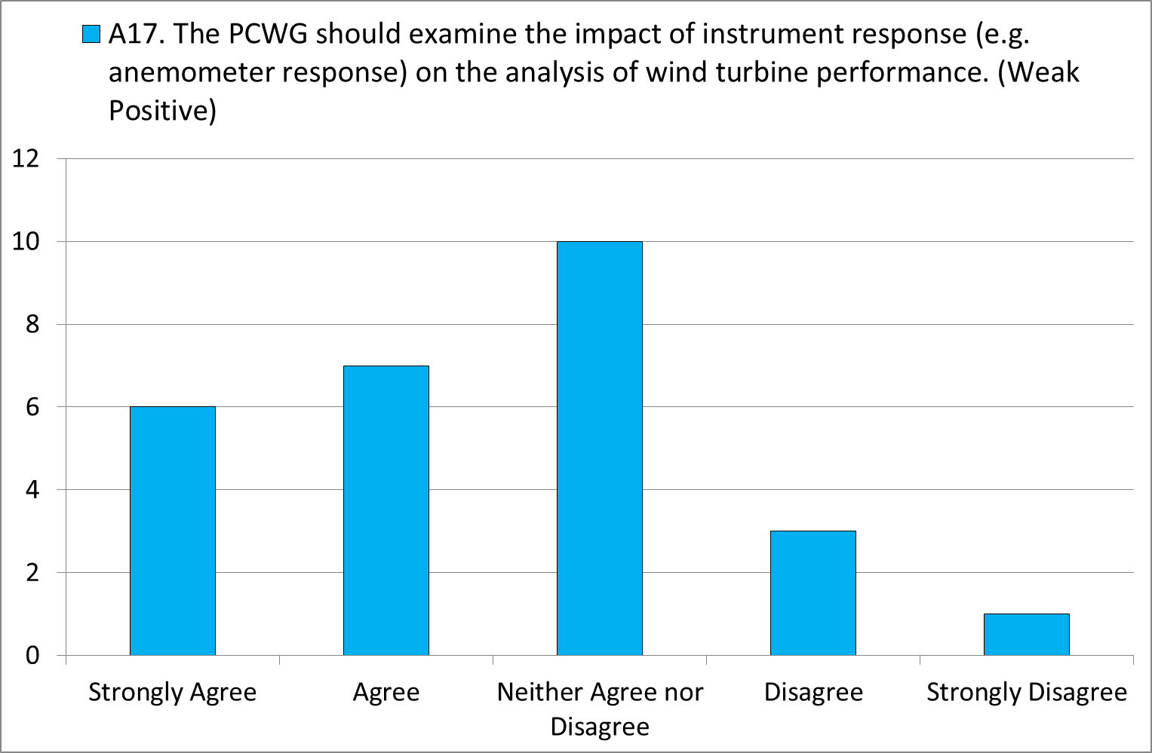
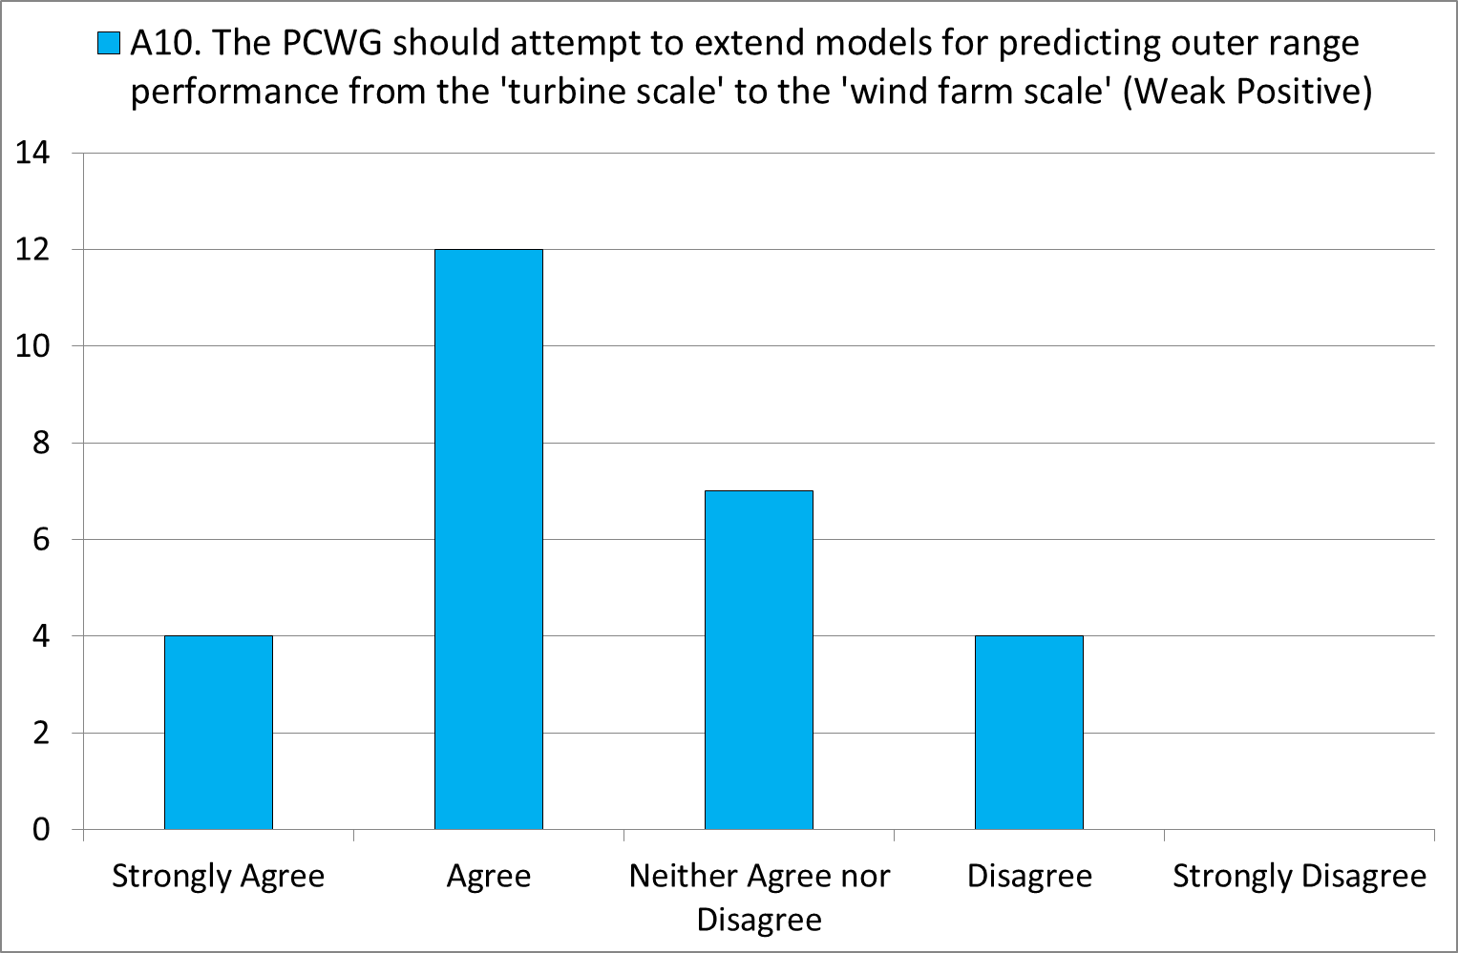
Comment from participant:
Some of these areas feel like second order effects (anemometer response) that are better suited to other expert groups. Also, although the question of performance in a waked flow is important, the PCWG (as it currently exists) should complete work on a single turbine…

Slide 19
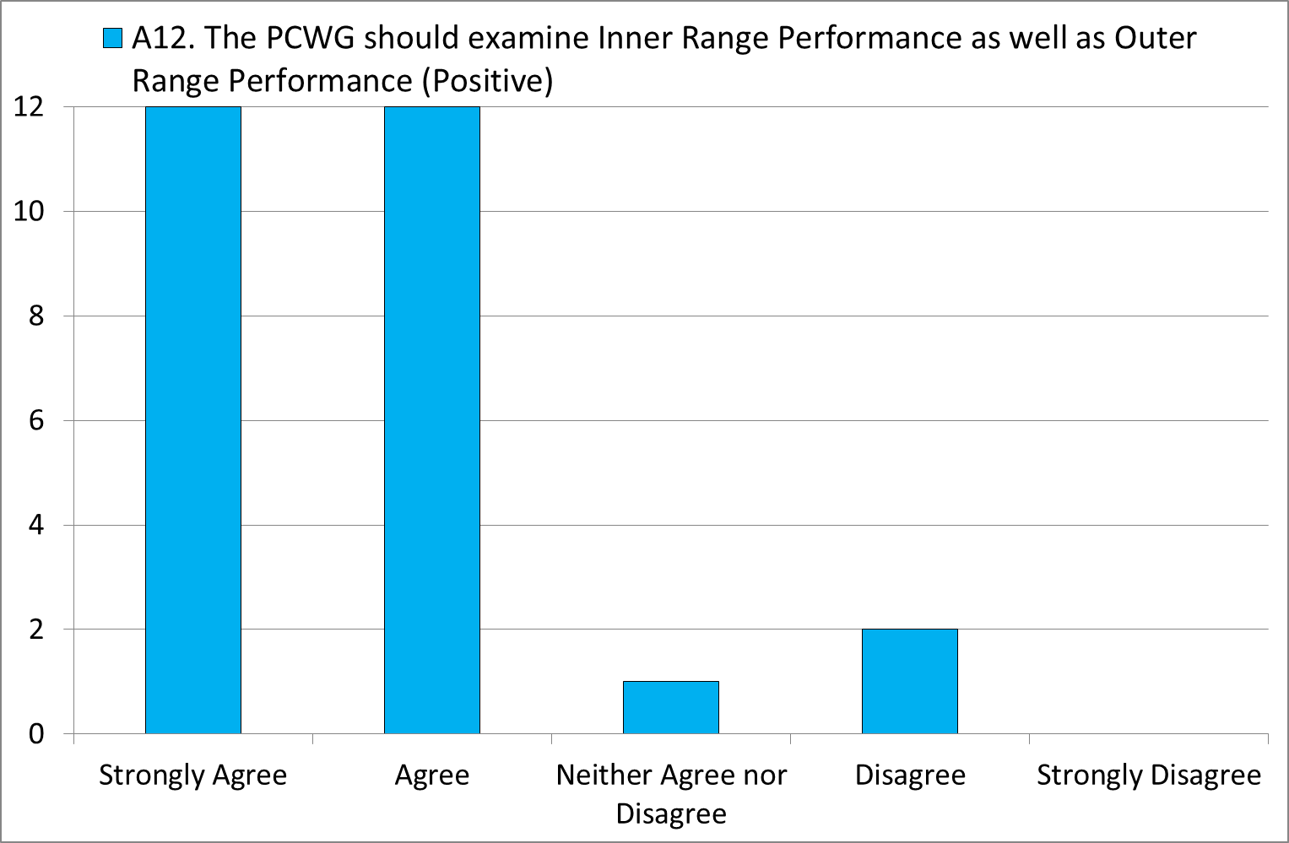
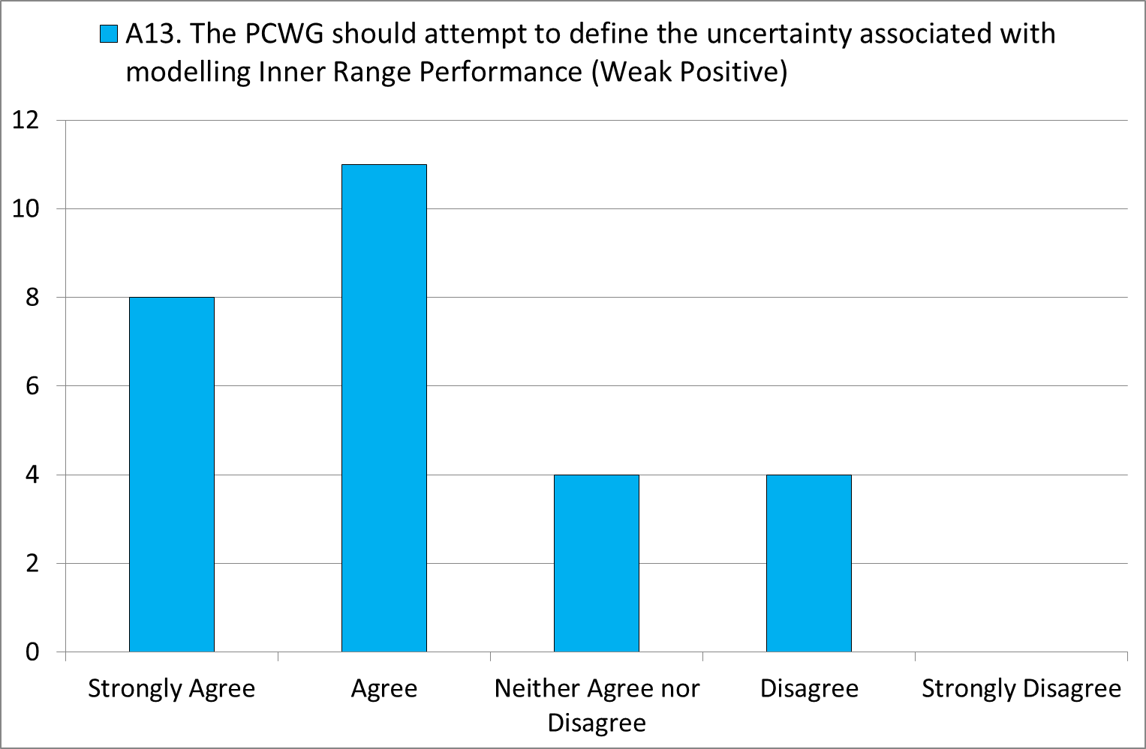
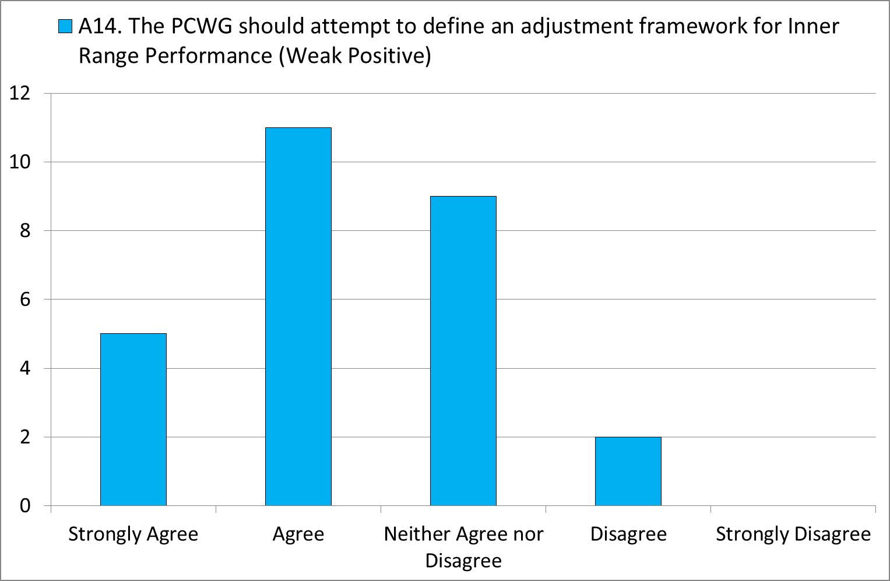
Comment from participant:
I actually think the difference between the measured inner range and the sales power curve is a higher impact and risk than the difference between the inner- and outer-range.

Slide 20
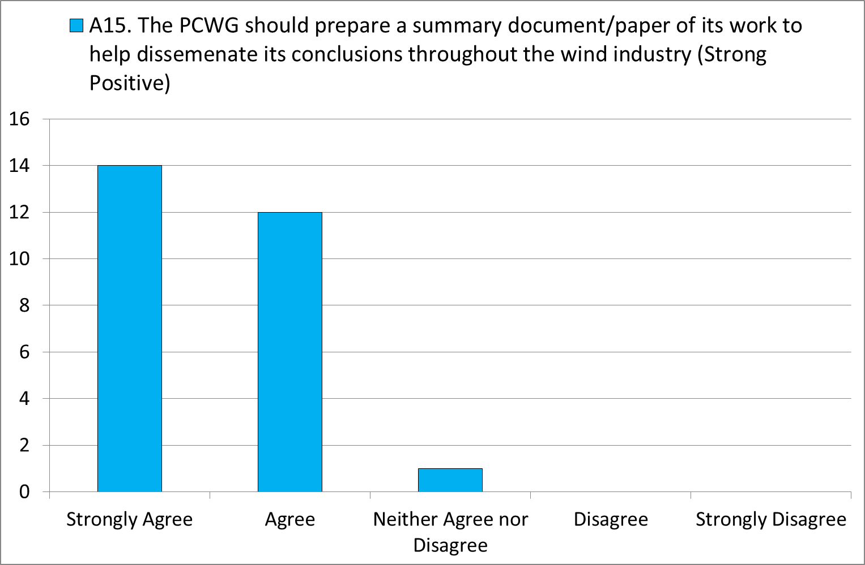

Slide 21
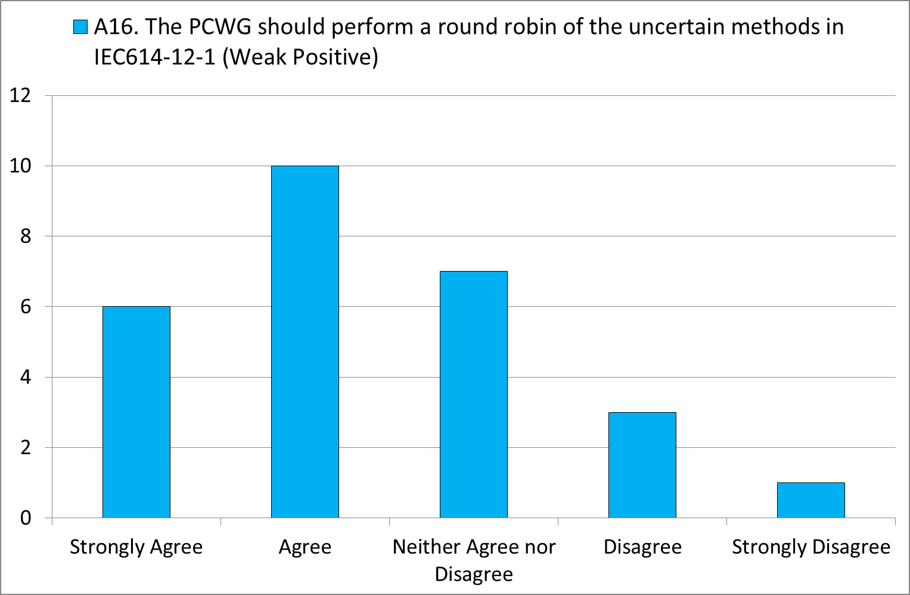

Slide 22
Strongest Positive Responses
Rank | Score | Classification | Question
1 | 1.6 | Strong Positive | T6. The communication of power curve information should be harmonised to make it easier to apply corrections for outer range conditions (Strong Positive)
2 | 1.5 | Strong Positive | C1. Real world wind conditions are composed of both inner range and outer range wind conditions. (Strong Positive)
2 | 1.5 | Strong Positive | A15. The PCWG should prepare a summary document/paper of its work to help dissemenate its conclusions throughout the wind industry (Strong Positive)
4 | 1.4 | Positive | T1. The wind energy industry should define validated consensus methods for predicting wind turbine power output in outer range conditions for the purposes of resource assessment. (Positive)
4 | 1.4 | Positive | A6. The PCWG should continue to develop a document to harmonise the communication of power curve information (Positive)
4 | 1.4 | Positive | A2. The PCWG should attempt to define the uncertainty associated with modelling outer range conditions. (Positive)
4 | 1.4 | Positive | T4. Investors should clearly understand which conditions are warranted and which are not. (Positive)
4 | 1.4 | Positive | T5. Power performance tests should make some consideration of outer range conditions. (Positive)

Slide 23
Weakest Responses
Rank | Score | Classification | Question
25 | 0.6 | Weak Positive | C6. The failure to consider outer range conditions in power performance tests increases the risk perceived by wind energy investors. (Weak Positive)
25 | 0.6 | Weak Positive | A10. The PCWG should attempt to extend models for predicting outer range performance from the 'turbine scale' to the 'wind farm scale' (Weak Positive)
25 | 0.6 | Weak Positive | A16. The PCWG should perform a round robin of the uncertain methods in IEC614-12-1 (Weak Positive)
25 | 0.6 | Weak Positive | A9. The PCWG should try and close the gap between engineering models, full aeroelastic models and observations. (Weak Positive)
29 | 0.5 | Weak Positive | A8. The PCWG should use aeroelastic models to examine the physical reasons for observed performance in outer range conditions. (Weak Positive)
29 | 0.5 | Weak Positive | A17. The PCWG should examine the impact of instrument response (e.g. anemometer response) on the analysis of wind turbine performance. (Weak Positive)
29 | 0.5 | Weak Positive | A11. The PCWG should attempt to extend models for predicting outer range performance from 'free stream' to 'waked flow' (Weak Positive)

Slide 24
PCWG 2015 Roadmap – A3 Report Introduction
PCWG
9th Meeting: 12 December 2014 - Glasgow

Slide 25
Brief Introduction to A3 Report Format
The PCWG 2016 Road Map will use the A3 Report Format.
Background
(Reasons for Action)
Confirmed State
Have we got there!
Current Industry State
(Where we are now)
Gap
Target Industry State
(Where we need to be)
Reasons for gap between current and target
PCWG 2015 Actions

Slide 26
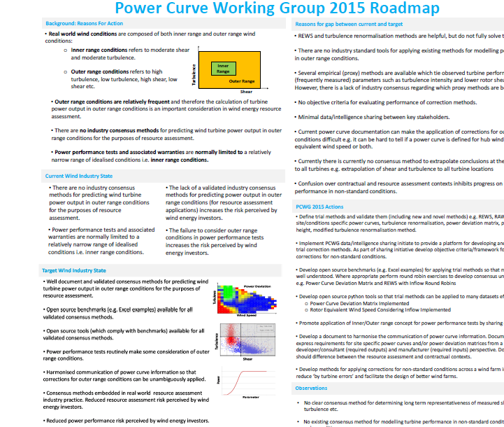
A3 Report Format
A3 Report Format: Statement of problem and solution designed to fit on a single A3 page.
Report divided into 7 boxes*:
Reasons for action
Current State
Target State
Gap Analysis
Action Plan
Confirmed State
Insights and Observations
(what do next)
* Variants of the A3 report with up to 9 boxes exist, but the PCWG is working with a relatively simple form of the A3 report.
A3 thinking was pioneered by Toyota:: http://www.amazon.co.uk/Understanding-A3-Thinking-Component-Management/dp/1563273608
Plan
Do
Check
Act

Slide 27
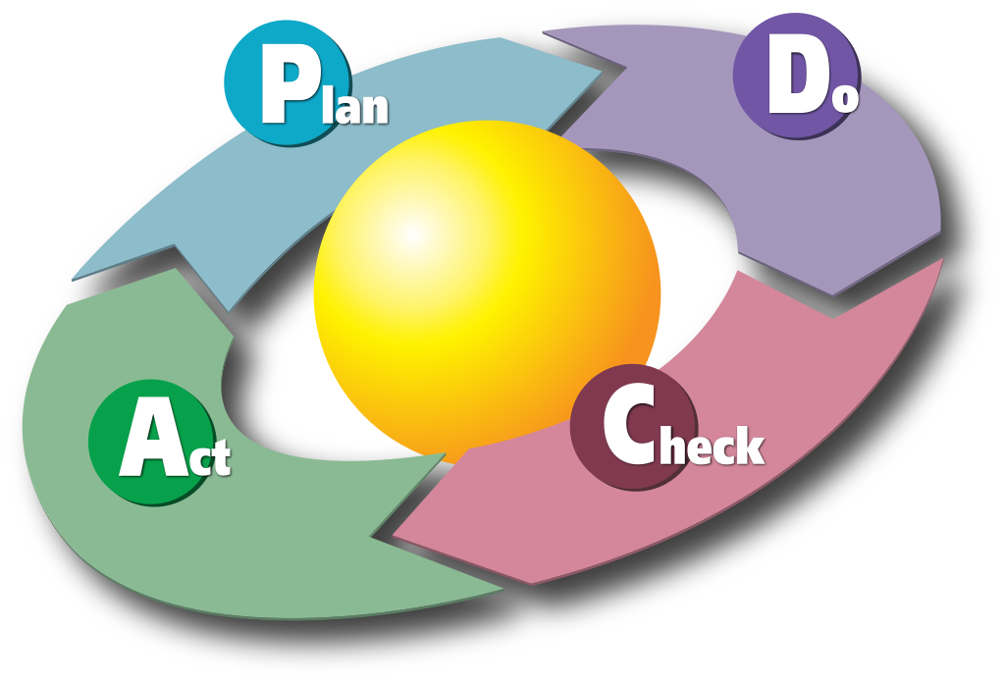
A3 Thinking: Plan, Do, Check, Act (PDCA)
Plan: Develop a hypothesis and experiential design.
Do: Conduct the experiment
Check: Collect measurements and results
Act: Interpreting results and taking appropriate action
Continuous Improvement
PCWG-Share-X
Diagram by Karn G. Bulsuk (http://www.bulsuk.com)

Slide 28
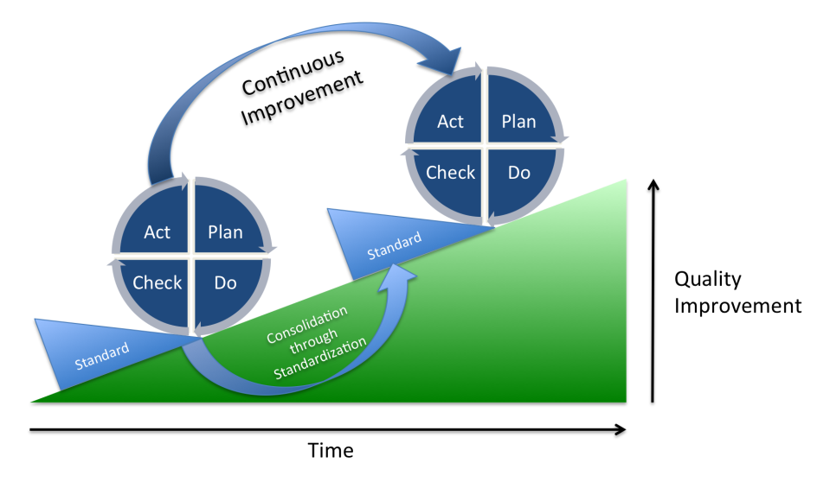
A3 Thinking: Plan, Do, Check, Act (PDCA)
Plan:
Study problem (understand from many different viewpoints).
Evaluate quantitatively.
Identify root cause.
Develop one or more candidate solution for the problem.
Do:
Put plan into action.
Check:
Measure effects of action
Compare to target/prediction
Act:
Establish the new process if the results are satisfactory.
Take remedial action if they are not.
"PDCA Process" by Johannes Vietze - Own work. Licensed under CC BY-SA 3.0 via Wikimedia Commons - https://commons.wikimedia.org/wiki/File:PDCA_Process.png#/media/File:PDCA_Process.png

Slide 29
Confirmed State Box
The Confirmed State box is where we measure our progress towards our target state.
The Intelligence Sharing Initiative has a fundamental link to this box:
PCWG-Share-01 measures the performance of methods currently available to the group (baseline data at end of 2015).
PCWG-Share-X measures the performance increase obtained by future methodological improvements.
PCWG-Share-01 provides a measure of where we are now and a platform for measuring the impact of future improvements.
Prediction
Error
2015
(Share-01)
Q1-16
(Share-02)
Q2-16
(Share-03)
Q3-16
(Share-04)
Q4-16
(Share-05)
Inclusion of the Confirmed state box in the 2016 roadmap will enable the full PDCA A3 Cycle (Plan Do Check Act)

Slide 30
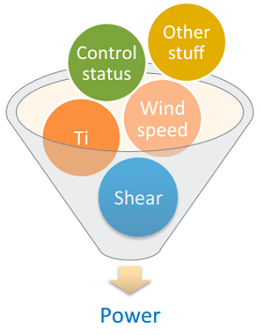
PCWG-Share-X: Methods
Final PCWG-Share-01 Methods:
Rotor Equivalent Wind Speed (IEC 61400-12-01)
Turbulence Correction (IEC 61400-12-01)
Rotor Equivalent Wind Speed & Turbulence Correction
2D Power Deviation Matrix
Possible PCWG-Share-02 Methods:
Machine Learning
Production By Height
3D Power Deviation Matrix
Criteria for Examining a Method with PCWG-Share-X:
Well discussed and understood within PCWG.
Open source benchmarks defined (e.g. excel benchmarks)
Implemented in PCWG Analysis Tool

